Slide 1
Divide & Conquer-1
Lecture-2: Divide & Conquer Paradigm: The Quick Sort Algorithm
Md. Golam Shahriar,
Lecturer, Dept. of CSE, VU.

Slide 2
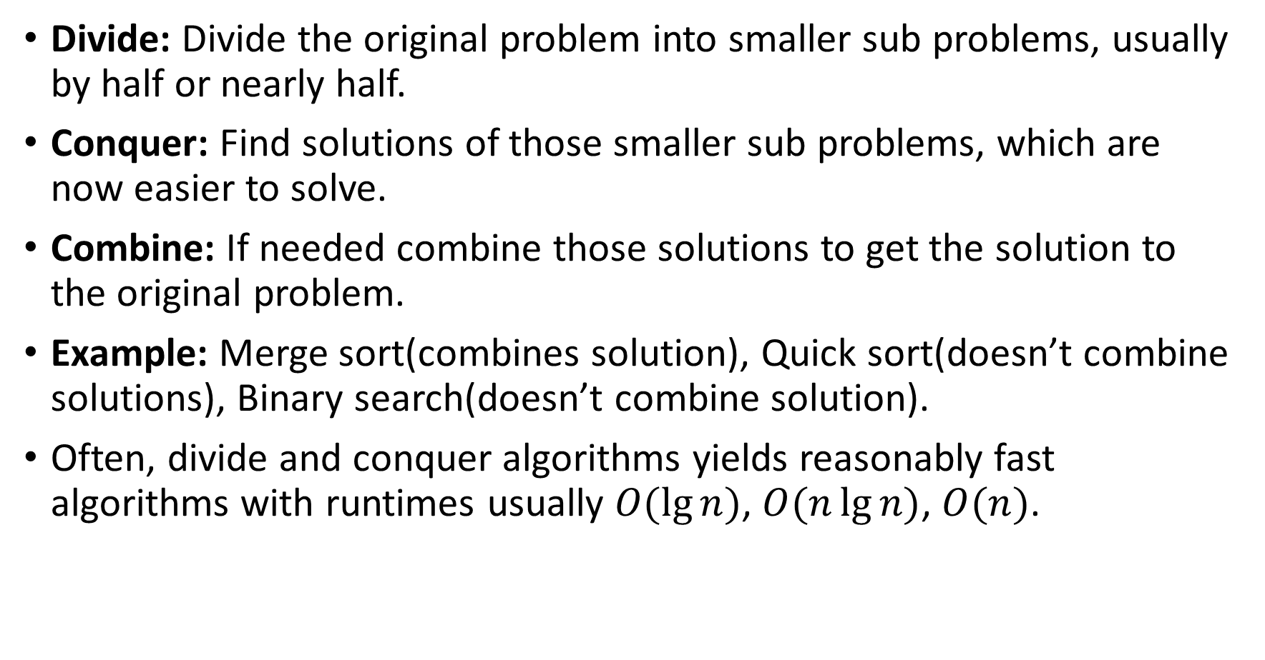
Divide and Conquer: The Principles
Divide: Divide the original problem into smaller sub problems, usually by half or nearly half.
Conquer: Find solutions of those smaller sub problems, which are now easier to solve.
Combine: If needed combine those solutions to get the solution to the original problem.
Example: Merge sort(combines solution), Quick sort(doesn’t combine solutions), Binary search(doesn’t combine solution).
Often, divide and conquer algorithms yields reasonably fast algorithms with runtimes usually $O(\lg{n})$, $O(n\lg{n})$, $O(n)$.

Slide 3
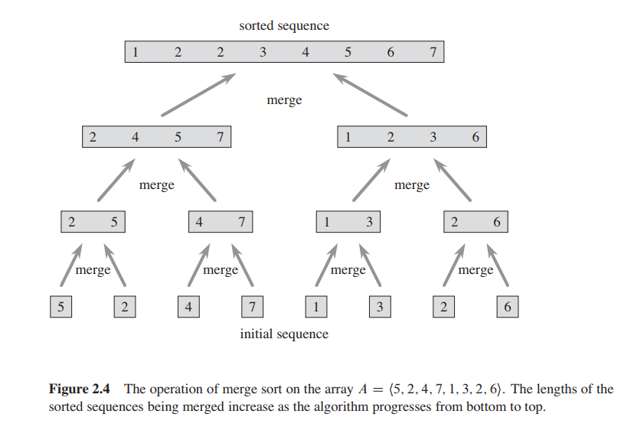
Combine Step (Merge Sort Recursion Tree)

Slide 4
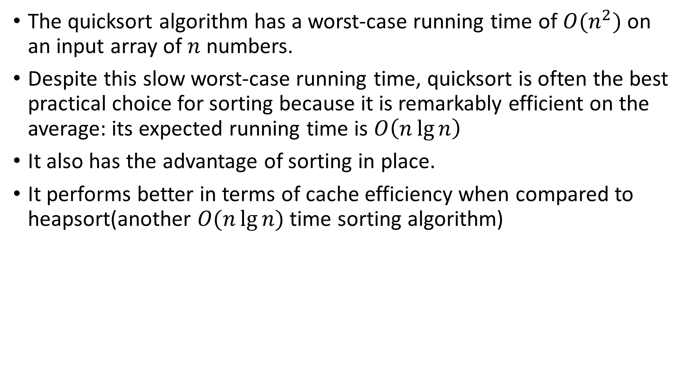
The Quick Sort Algorithm
The quicksort algorithm has a worst-case running time of $O(n^{2})$ on an input array of $n$ numbers.
Despite this slow worst-case running time, quicksort is often the best practical choice for sorting because it is remarkably efficient on the average: its expected running time is $O\left(n\lg{n}\right)$
It also has the advantage of sorting in place.
It performs better in terms of cache efficiency when compared to heapsort(another $O(n\lg{n})$time sorting algorithm)

Slide 5
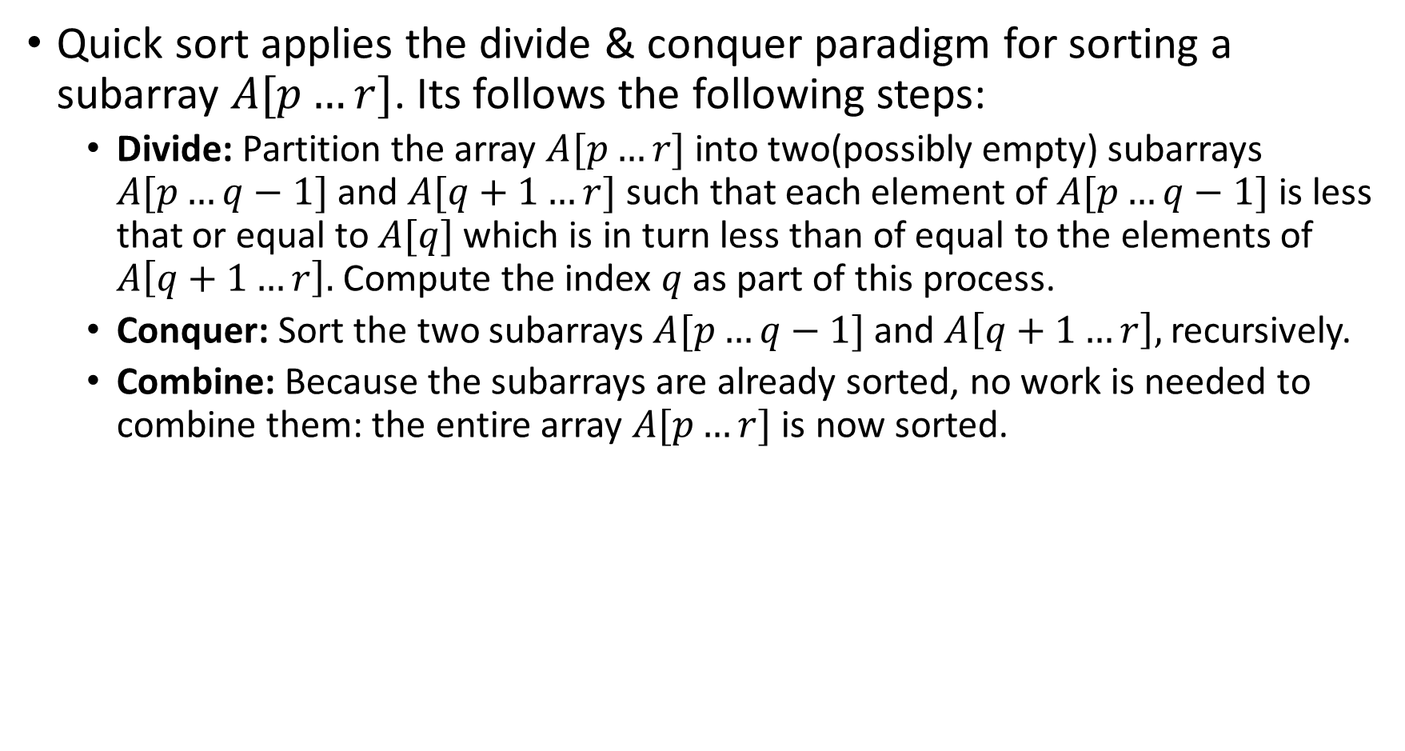
Description of The Algorithm
Quick sort applies the divide & conquer paradigm for sorting a subarray $A[p…r]$. Its follows the following steps:
Divide: Partition the array $A[p…r]$ into two(possibly empty) subarrays $A[p…q−1]$ and $A[q+1…r]$ such that each element of $A[p…q−1]$ is less that or equal to $A[q]$ which is in turn less than of equal to the elements of $A\left[q+1…r\right].$Compute the index $q$ as part of this process.
Conquer: Sort the two subarrays $A[p…q−1]$ and $A\left[q+1…r\right],$ recursively.
Combine: Because the subarrays are already sorted, no work is needed to combine them: the entire array $A[p…r]$ is now sorted.

Slide 6
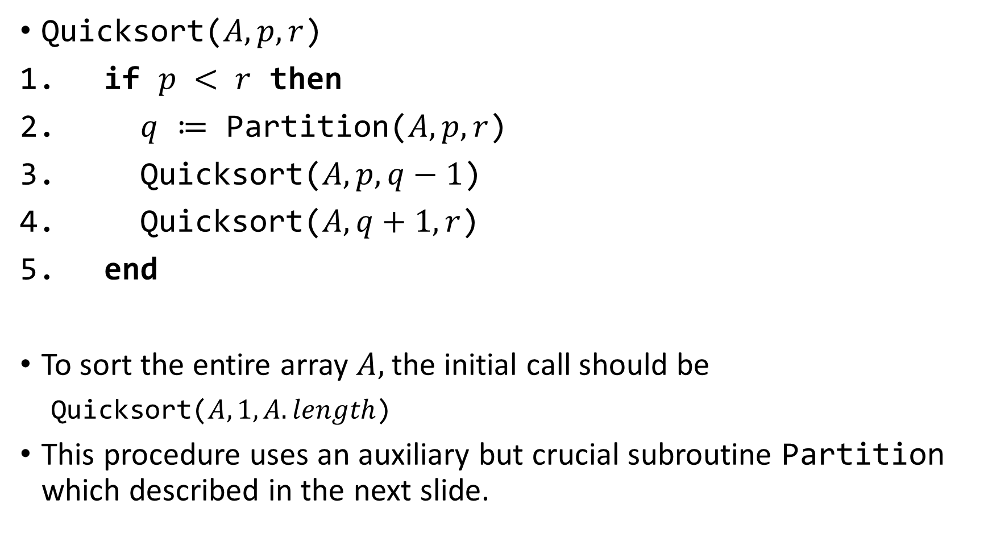
The Main Algorithm
Quicksort($A, p, r$)
if $p < r$ then
$q$ $≔$ Partition($A, p, r$)
Quicksort($A, p, q−1$)
Quicksort($A, q+1, r$)
end
To sort the entire array $A,$the initial call should be
Quicksort($A, 1, A.length$)
This procedure uses an auxiliary but crucial subroutine Partition which described in the next slide.

Slide 7
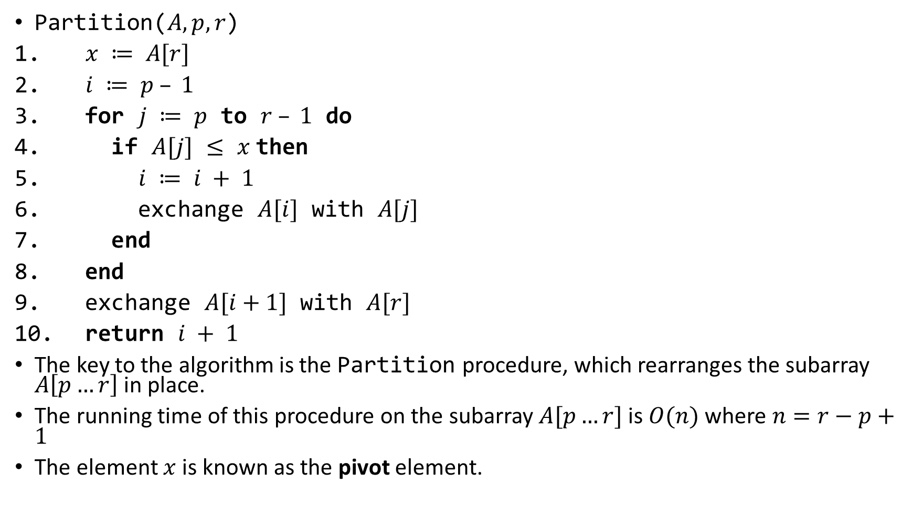
The Auxiliary Subroutine: Partition
Partition($A, p, r$)
$x ≔ A[r]$
$i ≔ p – 1$
for $j ≔ p$ to $r – 1$ do
if $A[j]$ $≤$ $x$then
$i ≔ i + 1$
exchange $A[i]$ with $A[j]$
end
end
exchange $A[i+1]$ with $A[r]$
return $i + 1$
The key to the algorithm is the Partition procedure, which rearranges the subarray $A\left[p…r\right]$ in place.
The running time of this procedure on the subarray $A[p…r]$ is $O(n)$ where $n=r−p+1$
The element $x$ is known as the pivot element.

Slide 8
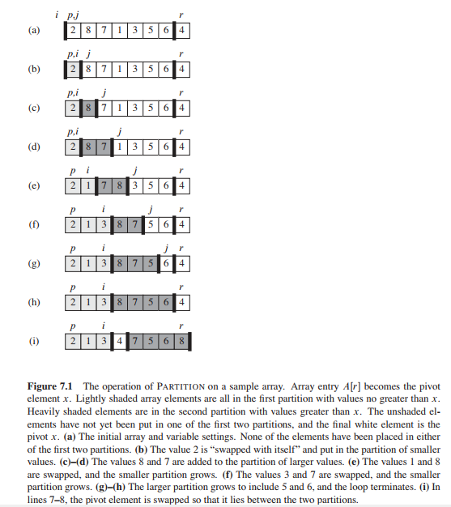

Slide 9
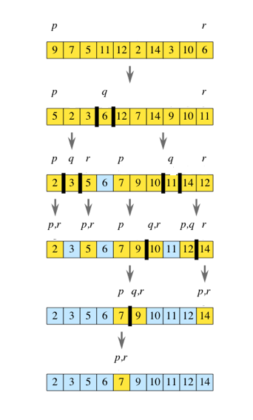

Slide 10
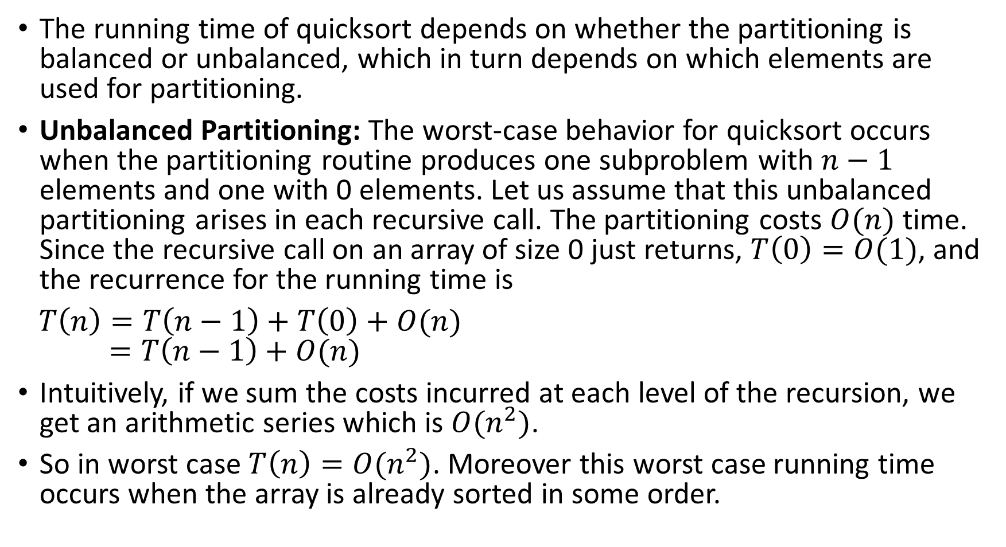
Performance Analysis of Quicksort
The running time of quicksort depends on whether the partitioning is balanced or unbalanced, which in turn depends on which elements are used for partitioning.
Unbalanced Partitioning: The worst-case behavior for quicksort occurs when the partitioning routine produces one subproblem with $n−1$ elements and one with 0 elements. Let us assume that this unbalanced partitioning arises in each recursive call. The partitioning costs $O(n)$ time. Since the recursive call on an array of size 0 just returns, $T\left(0\right)=O(1)$, and the recurrence for the running time is
$T\left(n\right)=T\left(n−1\right)+T\left(0\right)+O(n)$ $=T\left(n−1\right)+O(n)$
Intuitively, if we sum the costs incurred at each level of the recursion, we get an arithmetic series which is $O(n^{2})$.
So in worst case $T\left(n\right)=O(n^{2})$. Moreover this worst case running time occurs when the array is already sorted in some order.

Slide 11
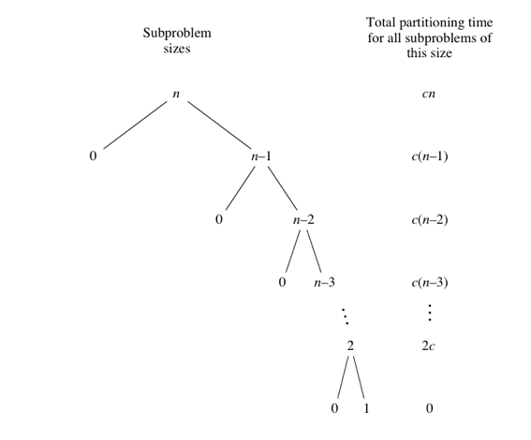

Slide 12
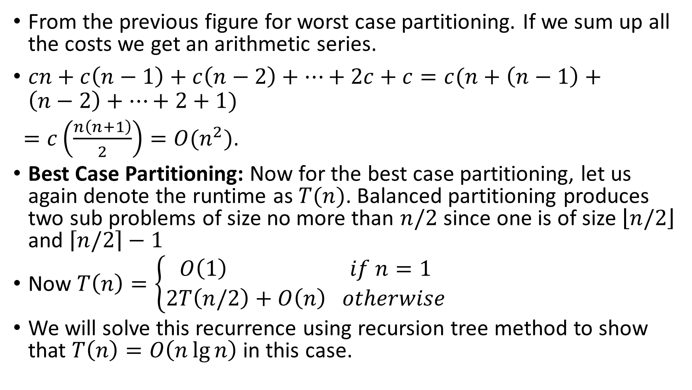
Performance Analysis of Quicksort(contd.)
From the previous figure for worst case partitioning. If we sum up all the costs we get an arithmetic series.
$cn+c\left(n−1\right)+c\left(n−2\right)+…+2c+c=c(n+\left(n−1\right)+\left(n−2\right)+…+2+1)$
$=c\left(\frac{n\left(n+1\right)}{2}\right)=O(n^{2})$.
Best Case Partitioning: Now for the best case partitioning, let us again denote the runtime as $T(n)$. Balanced partitioning produces two sub problems of size no more than $n/2$ since one is of size $\left\lfloor n/2\right\rfloor$ and $\left\lceil n/2\right\rceil −1$
Now $T\left(n\right)=\left\{\begin{aligned}O\left(1\right) if n=1 \\ 2T\left(n/2\right)+O\left(n\right) otherwise\end{aligned}\right.$
We will solve this recurrence using recursion tree method to show that $T\left(n\right)=O\left(n\lg{n}\right)$ in this case.

Slide 13
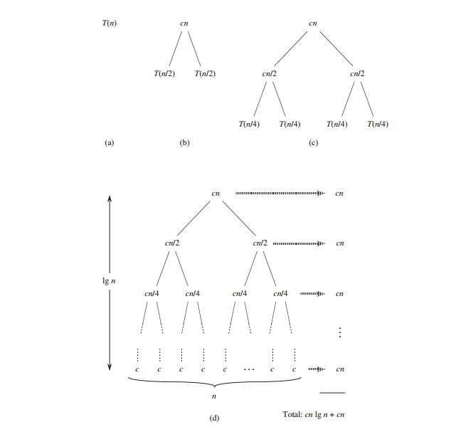

Slide 14
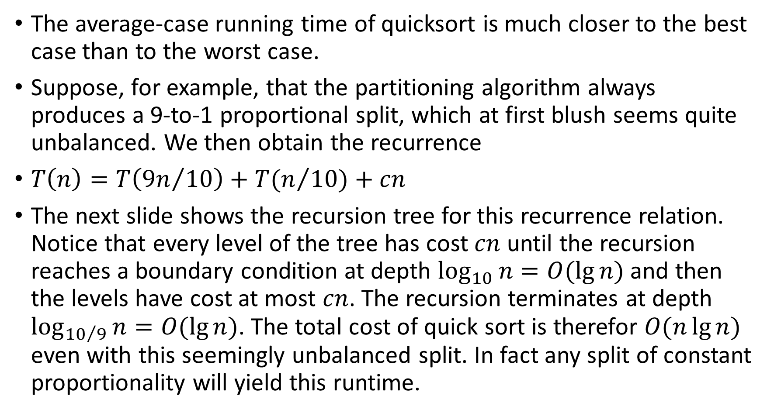
Balanced Partitioning
The average-case running time of quicksort is much closer to the best case than to the worst case.
Suppose, for example, that the partitioning algorithm always produces a 9-to-1 proportional split, which at first blush seems quite unbalanced. We then obtain the recurrence
$T\left(n\right)=T\left({9n}/{10}\right)+T(n/{10)}+cn$
The next slide shows the recursion tree for this recurrence relation. Notice that every level of the tree has cost $cn$ until the recursion reaches a boundary condition at depth $\log_{10}{n=O(\lg{n})}$ and then the levels have cost at most $cn$. The recursion terminates at depth $\log_{{10}/9}{n=O(\lg{n})}$. The total cost of quick sort is therefor $O(n\lg{n})$ even with this seemingly unbalanced split. In fact any split of constant proportionality will yield this runtime.

Slide 15
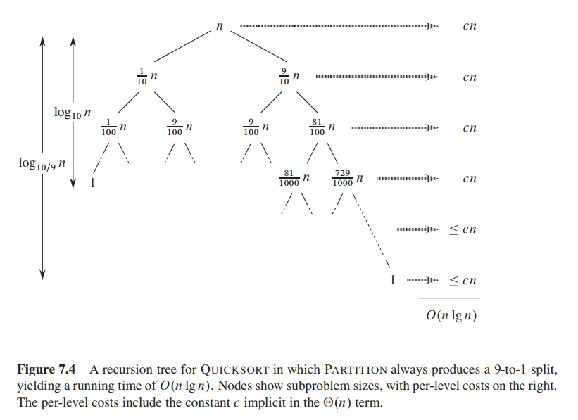

Slide 16

Some Remarks
It possible to show that the average(expected) running time of quicksort is $O(n\lg{n})$ for majority of input in practice.
Since the performance of quick sort relies on choosing a good pivot element, there are many ways of choosing a good pivot element, such as:
Randomly shuffle the array and then chose a pivot element

Slide 17
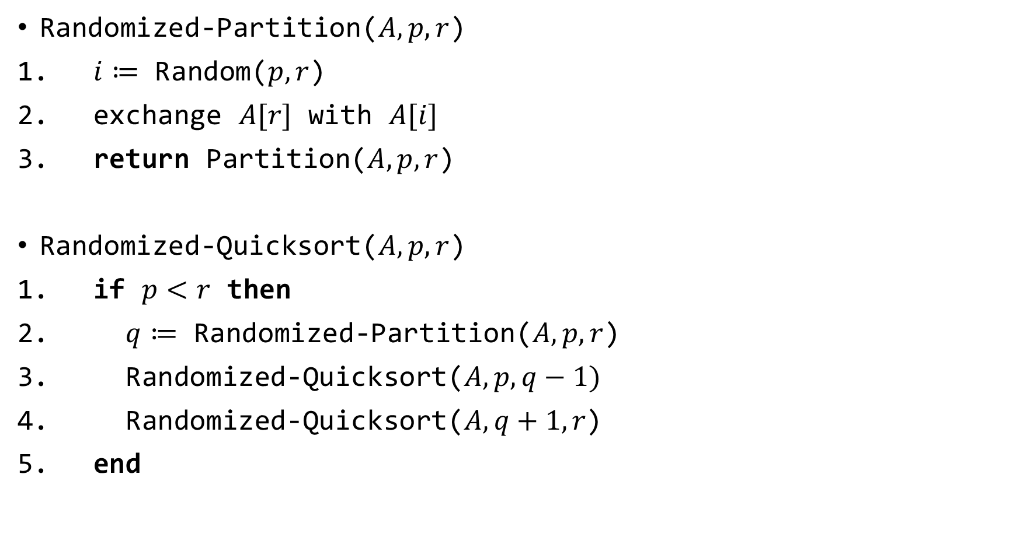
A Randomized Version
Randomized-Partition($A, p, r$)
$i≔$ Random($p, r$)
exchange $A[r]$ with $A[i]$
return Partition($A, p, r$)
Randomized-Quicksort($A, p, r$)
if $p<r$ then
$q≔$ Randomized-Partition($A, p, r$)
Randomized-Quicksort($A, p, q−1)$
Randomized-Quicksort($A, q+1, r$)
end

